Slide 1
CSE 1115 • SPRING 2026 • ASSESSMENT CLO2
Object-Oriented Software Design
Hospital Medical Equipment Management System
A polymorphic, safety-critical architecture for heterogeneous clinical devices.
PRESENTER
STUDENT ID
INSTITUTION
Pranta Mohajan
0222510005101025
Premier University, Chittagong

Slide 2

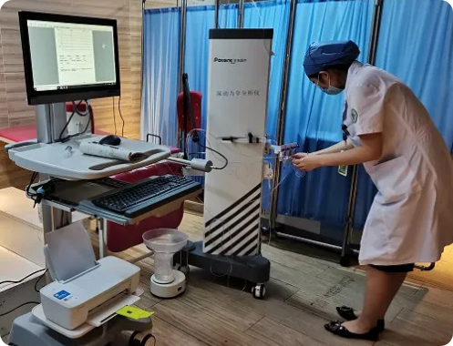
01 / Challenge Definition
PROBLEM DIAGNOSTICS
The Core Software Engineering Challenge
How to manage highly diverse clinical devices through a uniform interface without risking codebase collapse during future hospital expansion?
Heterogeneous Vitals
Mandatory Audit Logs
Ventilators regulate airway pressure while ECG units process electrical telemetry.
Strict regulatory compliance demands consistent, non-negotiable service audits.

Slide 3

02 / Structural Tier
CORE STRUCTURAL ENTITIES
System Architecture & Contracts
MedicalEquipment
Abstract Base Class
Encapsulates universal ID, equipment status, and maintenance dates while enforcing abstract start/stop operations.
5 Concrete Subclasses
Maintainable Interface
Ventilator, PatientMonitor, InfusionPump, ECGMachine, and Ultrasound encapsulate hardware-specific parameters.
Defines a standardized contract for inspection cycles, logging routines, and status audits across every device.
Inherits base identity • Customizes vital monitoring
Zero coupling to device type • Universal compliance

Slide 4
03 / Core Principles
THEORY APPLIED TO HEALTHCARE
Four Foundational OOP Pillars
Abstraction
01
Encapsulation
02
Hides physical hardware circuits behind clean, high-level operational contracts.
Guards device calibration data with private fields and validated state mutators.
Inheritance
03
Polymorphism
04
Reuses base identifiers and attaches specialized clinical monitoring attributes.
Dispatches device routines dynamically through a shared base reference.

Slide 5
04 / Extensibility
DESIGN DECISIONS & VIVA DEFENSE
UML Associations & Future Scalability
OPEN / CLOSED PRINCIPLE (OCP)
Key UML Structural Decisions
Zero-Downtime Extensibility
Composition (◆) — MaintenanceRecord
Strict lifecycle dependency: deleting an equipment instance destroys its corresponding service logs.
Adding an MRI machine or Defibrillator requires only a new subclass extending MedicalEquipment.
Aggregation (◇) — Hospital & Equipment
Loose coupling: hospital holds equipment references, but physical hardware exists independently.
Hospital inventory loop & maintenance scheduler require zero code modifications.

Slide 6
DEFENSE & CONCLUSION
Scalable, Safe & Extensible Healthcare Engineering
Connecting theoretical OOP constructs to real-world clinical equipment safety standards.
Thank You • Questions & Discussion
Department of Computer Science and Engineering • Premier University, Chittagong

